Slide 1
  Part1 : Cryptography
  (asymmetric key cryptography)
1

Slide 2
Roadmap
Asymmetric key cryptography
Diffie-Hellman
RSA
Korean crypto algorithms

Slide 3
Asymmetric key cryptography
Symmetric key cryptography
  requires sender, receiver know shared secret key
  difficulty of key management/distribution, O(n^2)
Asymmetric key cryptography
  also known as “public key cryptography”
  radically different approach [Diffie-Hellman76, RSA78]
  sender, receiver do not share secret key
  public encryption key known to all
  private decryption key known only to receiver
  O(n)

Slide 4
Asymmetric key cryptography
probably most significant advance in the 3000 year history of cryptography
uses two keys – a public & a private key
  Asymmetric
  Traditional symmetric cryptography uses one key
uses clever application of number theoretic concepts to function

Slide 5


Asymmetric key cryptography
Bob generates a pair of private and public key
Publish the public key
  Everybody knows this public key through
    Newspaper, his blog, certificate authority,…
  Two purposes : encryption and digital signature
+
Bob’s public
key
K
B
-
Bob’s private
key
K
B

Slide 6

Asymmetric key cryptography
Encryption
  Alice wants to send Bob m encrypted
  Uses Bob’s public key
    Nobody knows Bob’s private key, everybody knows Bob’s public key!
+
Bob’s public
key
K
-
Bob’s private
key
B
K
B
plaintext
message, m
encryption
algorithm
ciphertext
decryption
algorithm
plaintext
message
+
K (m)
-
+
B
m = K (K (m))
B
B

Slide 7
Asymmetric key cryptography
Encryption
  Nobody knows Bob’s private key, everybody knows Bob’s public key!
  Only Bob can decrypt the message
+
Bob’s public
key
K
-
Bob’s private
key
B
K
B
plaintext
message, m
encryption
algorithm
ciphertext
decryption
algorithm
plaintext
message
+
K (m)
-
+
B
m = K (K (m))
B
B

Slide 8
Asymmetric key cryptography
Digital signature
  Bob wants to sign m, digital signature
  Uses his private key
    Nobody knows Bob’s private key, everybody knows Bob’s public key!
+
Bob’s public
key
K
-
Bob’s private
key
B
K
B
plaintext
message, m
encryption
algorithm
ciphertext
decryption
algorithm
plaintext
message
+
K (m)
-
+
B
m = K (K (m))
B
B

Slide 9
Asymmetric key cryptography
Digital signature
  Nobody knows Bob’s private key, everybody knows Bob’s public key!
  Only Bob can sign m
  Everybody can verify that m is signed by Bob
-
Bob’s private
key
+
Bob’s public
key
K
K
B
B
plaintext
message, m
encryption
algorithm
ciphertext
decryption
algorithm
plaintext
message
-
K (m)
+
-
B
m = K (K (m))
B
B

Slide 10
Asymmetric key cryptography
Encryption v.s. Digital signature
  Encryption
    Encrypted with the public key
    Decrypted with the private key
  Digital signature
    Encrypted with the private key
    Decrypted with the public key

Slide 11
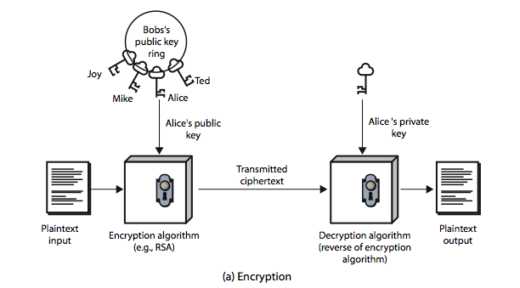
Asymmetric key cryptography

Slide 12
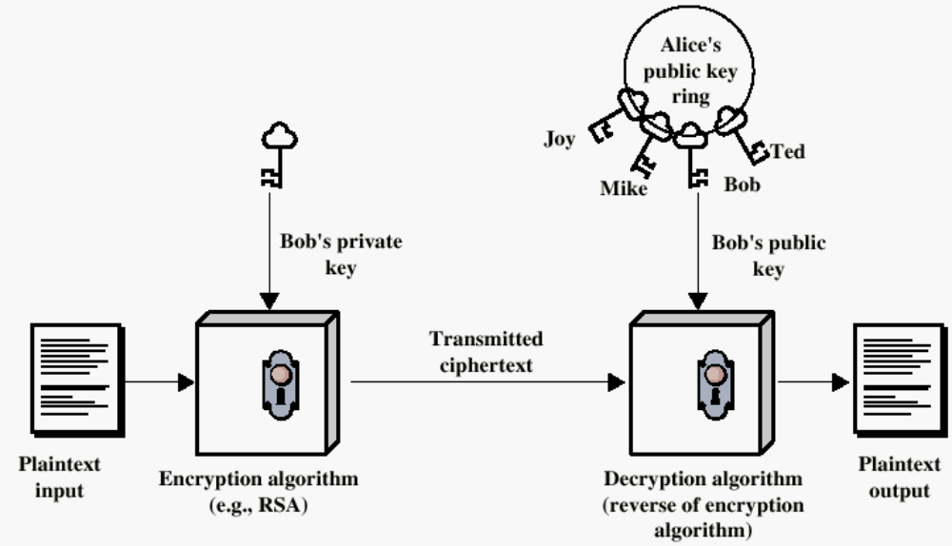
Asymmetric key cryptography

Slide 13
Asymmetric key cryptography
In general, asymmetric key cryptography requires lots of computational resources
  Heavy and slow
Used for establishing “symmetric key”
Used for signing “message digest”

Slide 14
Asymmetric key cryptography
Used for establishing “symmetric key”
K
Bob’s public
key
+
-
Bob’s private
key
B
K
B
session key,
k_{A-B}
encryption
algorithm
ciphertext
decryption
algorithm
plaintext
message
+
K (k_{A-B})
-
+
B
k_{A-B}=K (K (k_{A-B}))
B
B
K
K
A-B
A-B
plaintext
message, m
encryption
algorithm
ciphertext
decryption
algorithm
plaintext
m = K ( )
K (m)
K (m)
A-B
A-B
A-B

Slide 15

Asymmetric key cryptography
Used for signing “message digest”
Bob sends digitally signed message:
Alice verifies signature and integrity of digitally signed message:
large
message
m
H: Hash
function
encrypted
msg digest
H(m)
-
K_{B}(H(m))
Bob’s
private
key
digital
signature
(encrypt)
large
message
m
-
Bob’s
public
key
digital
signature
(decrypt)
K
B
+
H: Hash
function
K
encrypted
msg digest
B
+
-
K_{B}(H(m))
H(m)
H(m)
equal
?

Slide 16
Asymmetric key cryptography
Family of asymmetric key cryptography
  Diffie-Hellman
  RSA
  Elliptic curve

Slide 17
Diffie-Hellman
first public-key type scheme proposed
by Diffie & Hellman in 1976 along with the exposition of public key concepts
is a practical method for public exchange of a secret key
used in a number of commercial products

Slide 18
Diffie-Hellman
Basic theory
  security relies on the difficulty of computing discrete logarithms – hard
  exponentiation in a finite (Galois) field (modulo a prime or a polynomial) - easy

Slide 19
Diffie-Hellman
Alice and Bob agree on a large prime p and a number g less than p
  Public key : p, g
Alice selects a private number x and sends Bob the public number X = g ^{x} mod p
  Private key : x
Bob selects a private number y and sends Alice the public number Y = g ^{y} mod p
  Private key : y
Alice can compute K = Y^{x} = g ^{xy} mod p
Bob can compute K =X^{y} = g ^{xy} mod p

Slide 20
RSA
by Rivest, Shamir & Adleman of MIT in 1977
best known & widely used public-key scheme
private key / public key, use one to encrypt and the other to decrypt
Mostly used for short message encryption, digital signature, and secret key exchange
  security relies on the difficulty of factoring large numbers

Slide 21
RSA
each user generates a public/private key pair by:
selecting two large primes at random - p, q
computing their system modulus n=p.q
  note ø(n)=(p-1)(q-1)
  ø(n)is the number of positive integers less than n and relatively prime to n
selecting at random the encryption key e
    where 1<e<ø(n), gcd(e,ø(n))=1
solve following equation to find decryption key d
  e.d=1 mod ø(n) and 0≤d≤n
publish their public encryption key: PU={e,n}
keep secret private decryption key: PR={d,n}

Slide 22
RSA
to encrypt a message M the sender:
  obtains public key of recipient PU={e,n}
  computes: C = Me mod n, where 0≤M<n
to decrypt the ciphertext C the owner:
  uses their private key PR={d,n}
  computes: M = C^{d} mod n
note that the message M must be smaller than the modulus n (block if needed)

Slide 23
RSA
because of Euler's Theorem:
  a^{ø(n)}mod n = 1 where gcd(a,n)=1
in RSA have:
  n=p.q
  ø(n)=(p-1)(q-1)
  carefully chose e & d to be inverses mod ø(n)
  hence e.d=1+k.ø(n) for some k
hence :
C^{d} = M^{e.d} = M^{1+k.ø(n)} = M¹.(M^{ø(n)})^{k}
= M¹.(1)^{k} = M¹ = M mod n

Slide 24
RSA
Select primes: p=17 & q=11
Compute n = pq =17 x 11=187
  n should be at least 1024 bits in practice
Compute ø(n)=(p–1)(q-1)=16 x 10=160
Select e: gcd(e,160)=1; choose e=7
Determine d: de=1 mod 160 and d < 160 Value is d=23 since 23x7=161= 10x160+1
Publish public key PU={7,187}
Keep secret private key PR={23,187}

Slide 25
RSA
Alice
    Public key : (ea,na), private key: (da, na)
Bob
    Public key : (eb,nb), private key: (db, nb)
Encryption v.s. Digital signature
  Key exchange is nothing but one example of encryption

Slide 26
RSA
Bob
    Public key : (eb,nb), private key: (db, nb)
Encryption
  Alice → Bob
  M=key
  C = M^{eb} mod nb
  C^{db} = M^{eb.db} = M mod nb
  Key key
In general, used for key exchange purpose

Slide 27
RSA
Alice
    Public key : (ea,na), private key: (da, na)
Digital signature
  Alice → Bob
  M=a contract file
  C = M^{da} mod na
  C^{ea} = M^{da.ea} = M mod na
  M M

Slide 28
Korean crypto algorithms
Symmetric key (block cipher)
  SEED, ARIA
Asymmetric key (signature)
  KCDSA(Korea Certification-based Digital Signature Algorithm)
  EC-KCDSA(Korean Certificate-based Digital Signature Algorithm using Elliptic Curves)
Hash funct
  HAS-160(Hash function Algorithm Standard)

Slide 29
Reference
Cryptography and network security, W. Stallings, Prentice Hall, 2011
Network security: private communication in a public world, C. Kaufman, etc., Prentice Hall, 2002
Computer networking: a top-down approach, J. Kurose and K. Ross, Pearson, 2008
Lecture notes from “computer and network security”, S. Chen, University of Florida

